Slide 1

AIRPORT ANALYSIS
Data analysis and visualization of flight routes

Slide 2
Table of content
Dataset description
Goals
Methods
Visualizations
Conclusions

Slide 3


AIRPORT ANALYSIS
DATA VISUALIZATION
Data analysis and visualization of flight routes

Slide 4

OUR GROUP
GABRIELE DI PALMA
FRANCESCO DI STEFANO
FRANCESCO TRAMONTANO

Slide 5
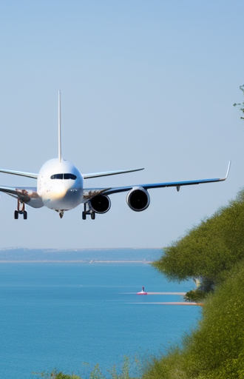
—Dr. Edward Tufte
"The main goal of data visualization is to communicate information clearly and effectively through graphical means."

Slide 6
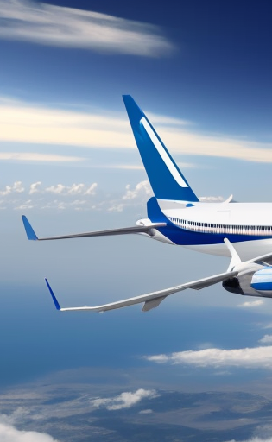




TABLE OF CONTENTS
EXPLORING THE DATASET
GOALS & METHODS
VISUALIZATIONS
CONCLUSIONS

Slide 7
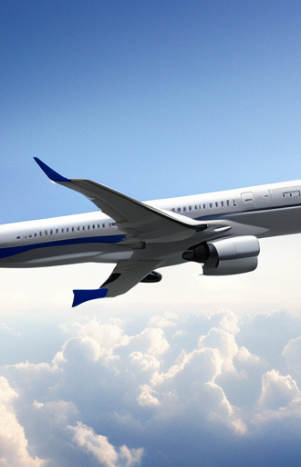
01
DATASET EXPLORATION
Main insights about the dataset

Slide 8
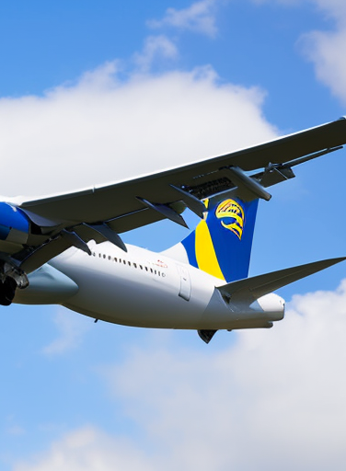
927,753 Flights
30 Years
1,000 Airports
In over
Among more than
Across the world

Slide 9
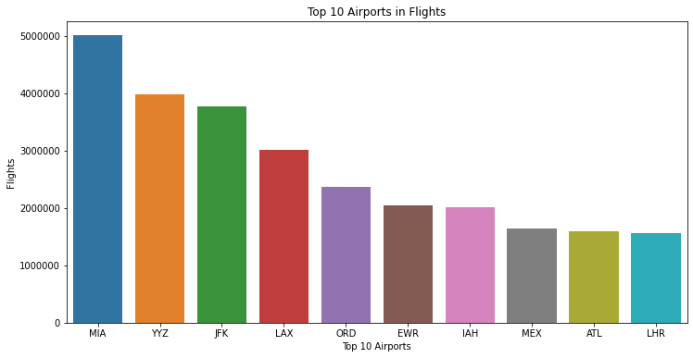
PLOTS
Our amazing plots

Slide 10
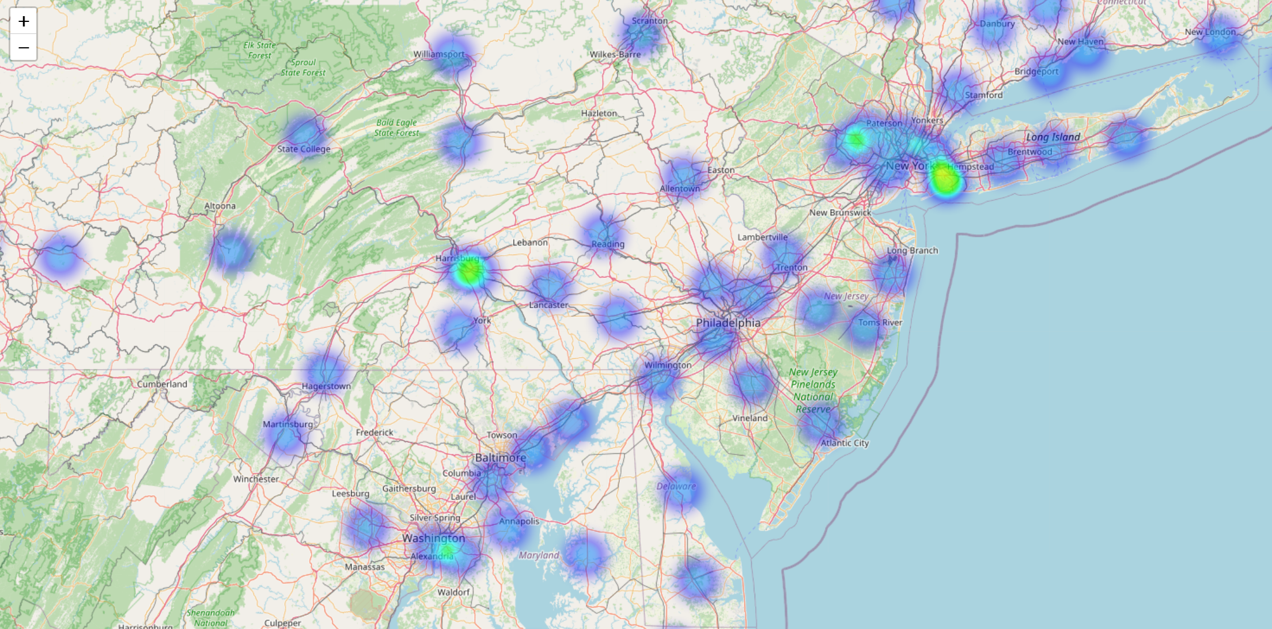
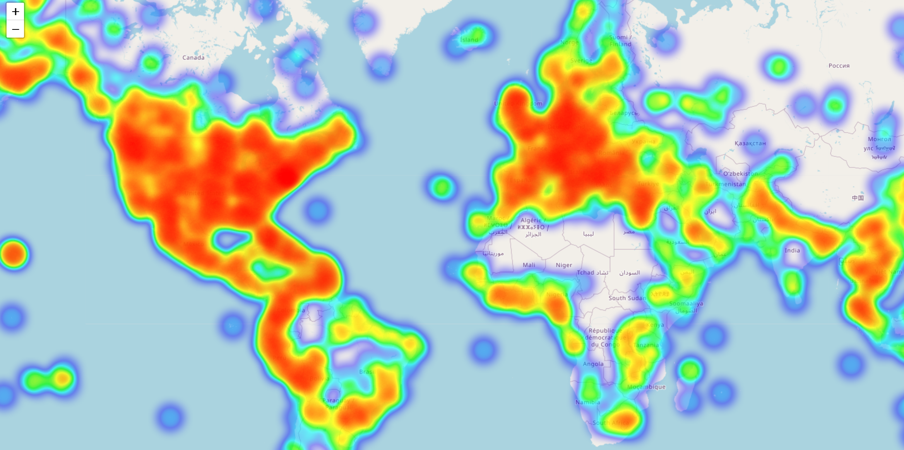
Another plot
INCREDIBILE
OKOK

Slide 11
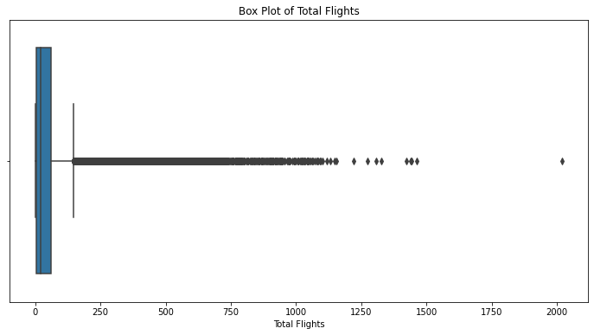
STATIC VISUALIZATIONS
BOXPLOT
BARPLOT
ok
ok

Slide 12
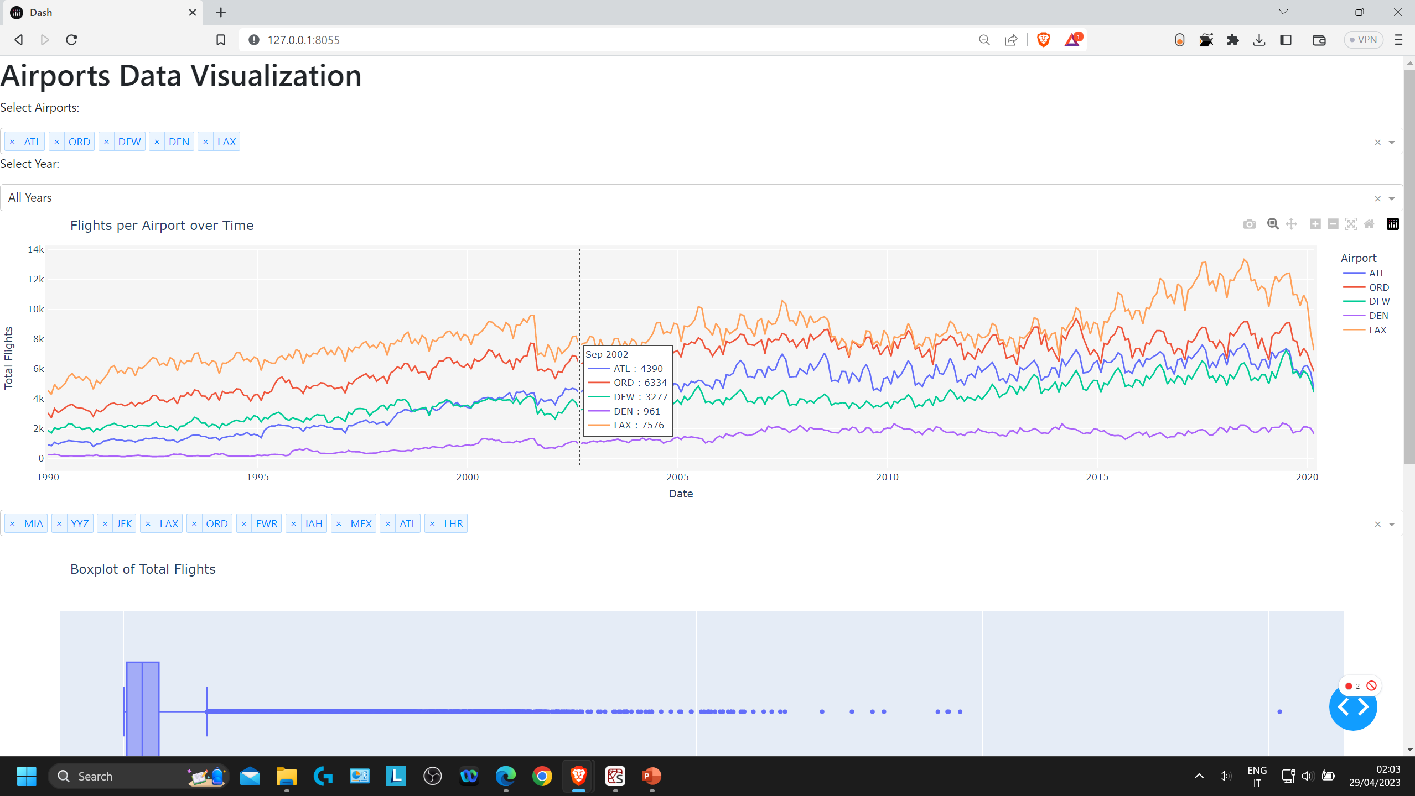
OUR WEBSITE
DASHHHHH

Slide 13

THANKS!
FRANCESCO TRAMONTANO
GABRIELE DI PALMA
FRANCESCO DI STEFANO

